Slide 1
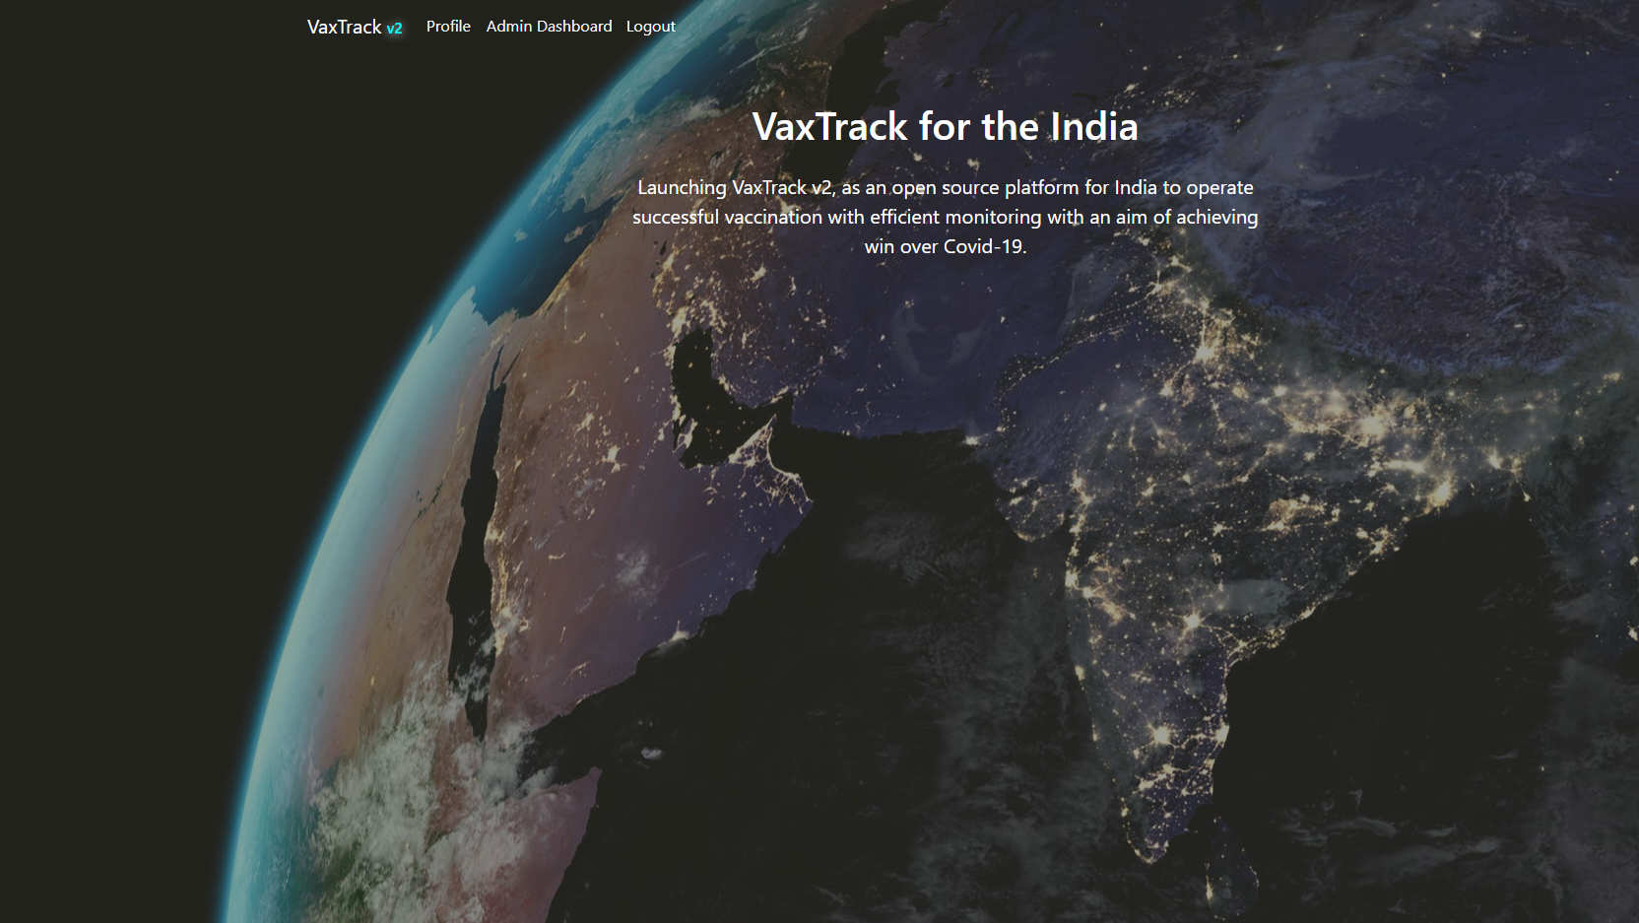
VAX TRACK v1 – Remastered (v1.1.0)
Vivek Kumar | Associate Consultant | Infosys
Developer | BP

Slide 2
AGENDA
Introduction
Case Study
Application Overview
Roles & Permission
Pages & Functionalities
Architecture & Database Design
Workflow Diagrams
Challenges & Solutions
Future Enhancements
Fixes & Modifications
Conclusion

Slide 3
INTRODUCTION
The COVID-19 pandemic has highlighted the critical need for efficient and accessible vaccination systems. To address this, we have developed a web-based application using the ASP.NET MVC framework. This application aims to streamline the vaccination process by providing a user-friendly portal for both normal users and administrators.
The primary purpose of this vaccination portal is to facilitate the booking and management of COVID-19 vaccination slots. The objectives include:
Simplifying the registration and booking process for users.
Providing administrators with tools to manage vaccination slots and user approvals efficiently.
Ensuring secure and accurate tracking of vaccination statuses.

Slide 4
CASE STUDY
Case Study: Streamlining COVID-19 Vaccination with ASP.NET MVC
Overview
The COVID-19 pandemic underscored the necessity for efficient and accessible vaccination systems. In response, we developed a web-based application using the ASP.NET MVC framework to streamline the vaccination process. This application serves as a user-friendly portal for both general users and administrators, aiming to simplify the booking and management of COVID-19 vaccination slots.
Objectives
Simplify Registration and Booking: Provide an intuitive interface for users to register and book vaccination slots easily.
Efficient Slot Management: Equip administrators with tools to manage vaccination slots and user approvals effectively.
Secure Tracking: Ensure secure and accurate tracking of vaccination statuses.
Implementation
User Registration and Booking
Users can create accounts and log in to the portal.
The system allows users to search for available vaccination slots based on location and date.
Users can book slots and receive confirmation notifications via email or SMS.
Administrator Tools
Administrators have access to a dashboard to view and manage all booked slots.
Tools are provided for approving or rejecting user registrations and slot bookings.
The system includes features for adding new vaccination centers and updating slot availability.
Security and Tracking
The application uses secure authentication methods to protect user data.
Vaccination statuses are updated in real-time and can be tracked by both users and administrators.
Detailed logs are maintained for all activities to ensure transparency and accountability.
Results
Increased Efficiency: The portal significantly reduced the time required for users to book vaccination slots.
Improved Management: Administrators reported a more streamlined process for managing slots and user approvals.
Enhanced Security: The secure tracking system ensured accurate and up-to-date vaccination records.

Slide 5
APPLICATION OVERVIEW
The vaccination portal is designed to cater to two types of users: normal users and administrators. Normal users can register, log in, and book vaccination slots, while administrators have additional functionalities to manage the overall vaccination process. The application ensures a seamless experience.
Key Features and Functionalities
User Registration and Login: New users can register and log in to the portal. Successful registration leads to auto-login and redirection to the user profile page.
User Profile Management: Users can view and update their profile information and check their vaccination status.
Slot Booking: Users can book available vaccination slots. The status changes from ‘not vaccinated’ to ‘vaccinated’ once approved by the admin.
Admin Dashboard: Administrators have access to a dashboard displaying total users, users yet to book slots, users with pending approvals, and available slots in hospitals.
Approval and Slot Management: Admins can approve vaccination statuses and update the number of available slots in hospitals.

Slide 6
Roles & Permissions
Tasks | User Role | Admin Role
Registration
Login
Slot Booking
Access User Profile Page
Access Dashboard Page
Approve Booked Slot
Update User’s Vaccination Status
Update Available Slots Count in Listed Hospitals

Slide 7
PAGES & FUNCTIONALITIES

Slide 8
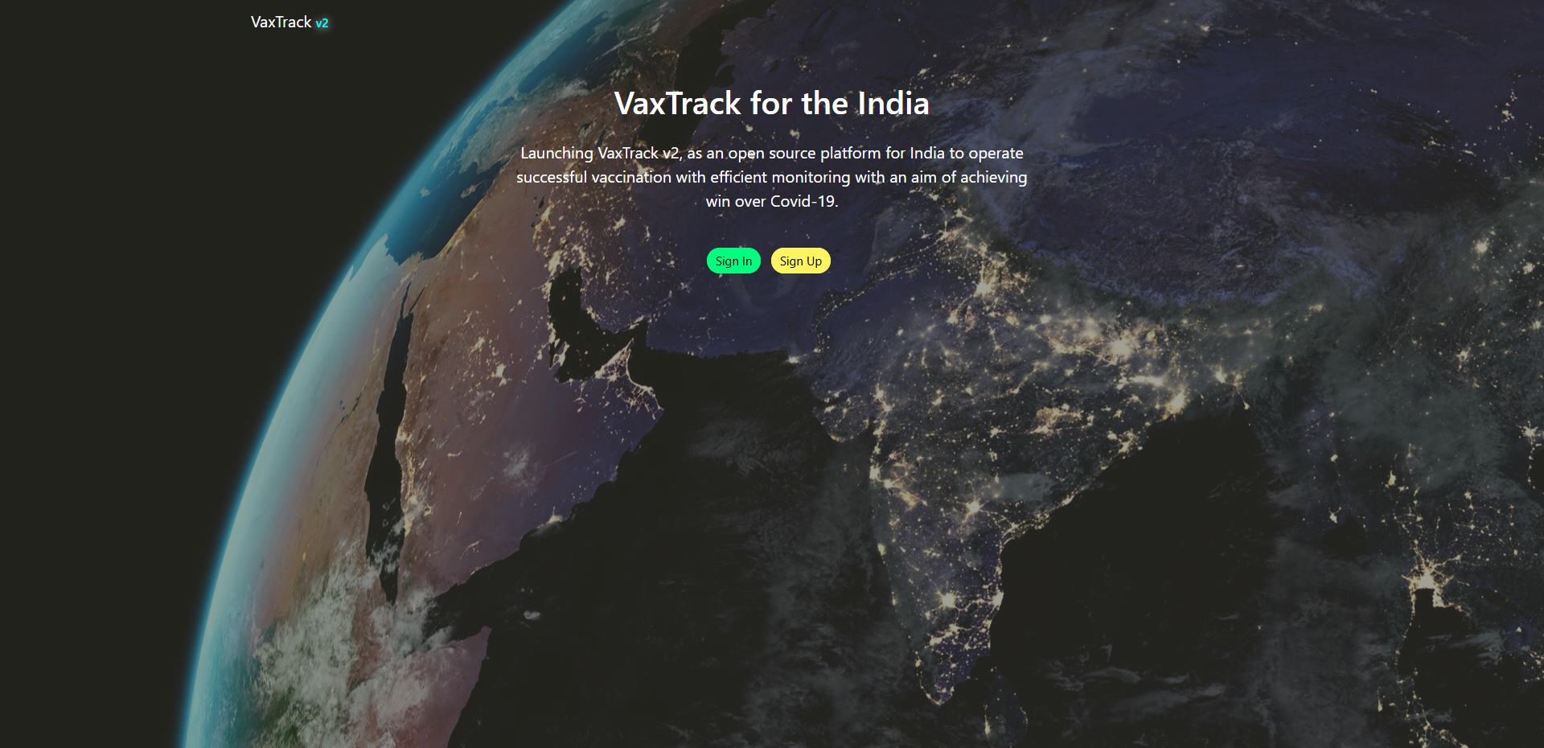
HOME PAGE

Slide 9
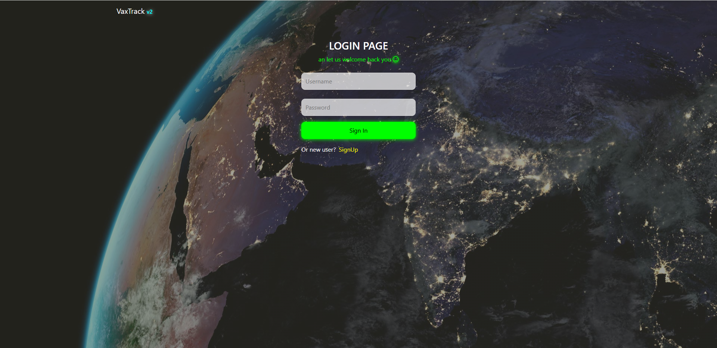
LOGIN PAGE

Slide 10
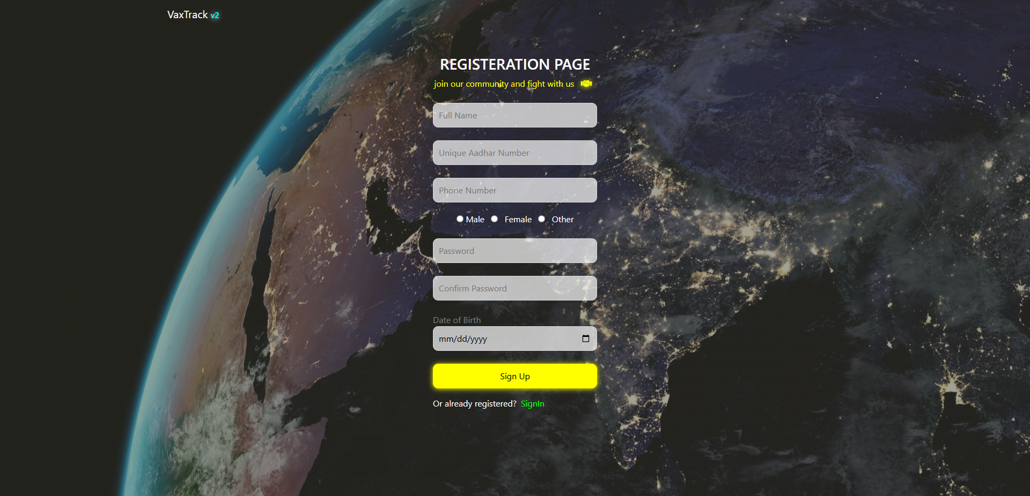
REGISTRATION PAGE

Slide 11
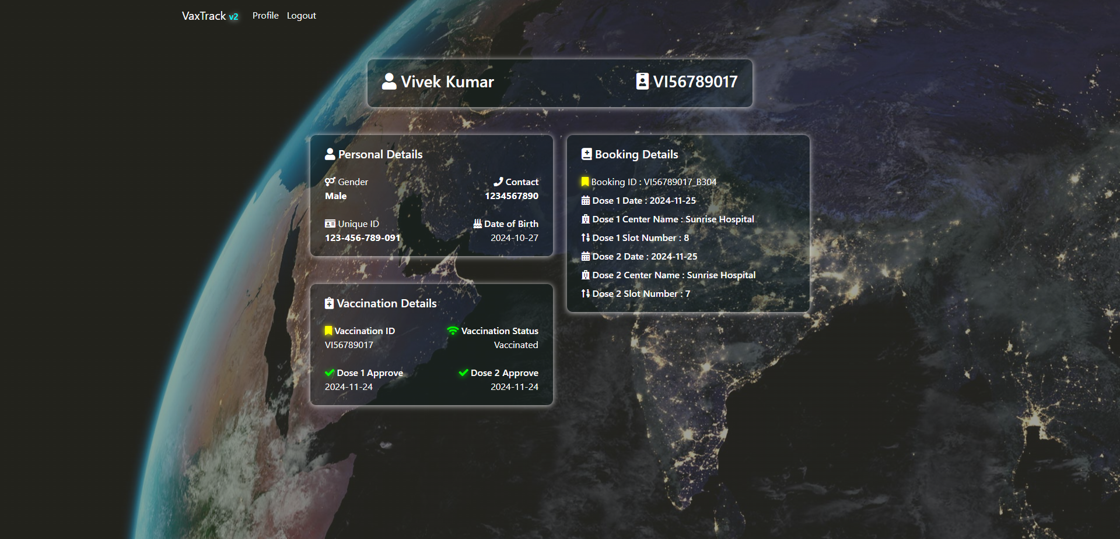
USER PROFILE PAGE – VACCINATED

Slide 12

USER PROFILE PAGE – PENDING APPROVAL

Slide 13
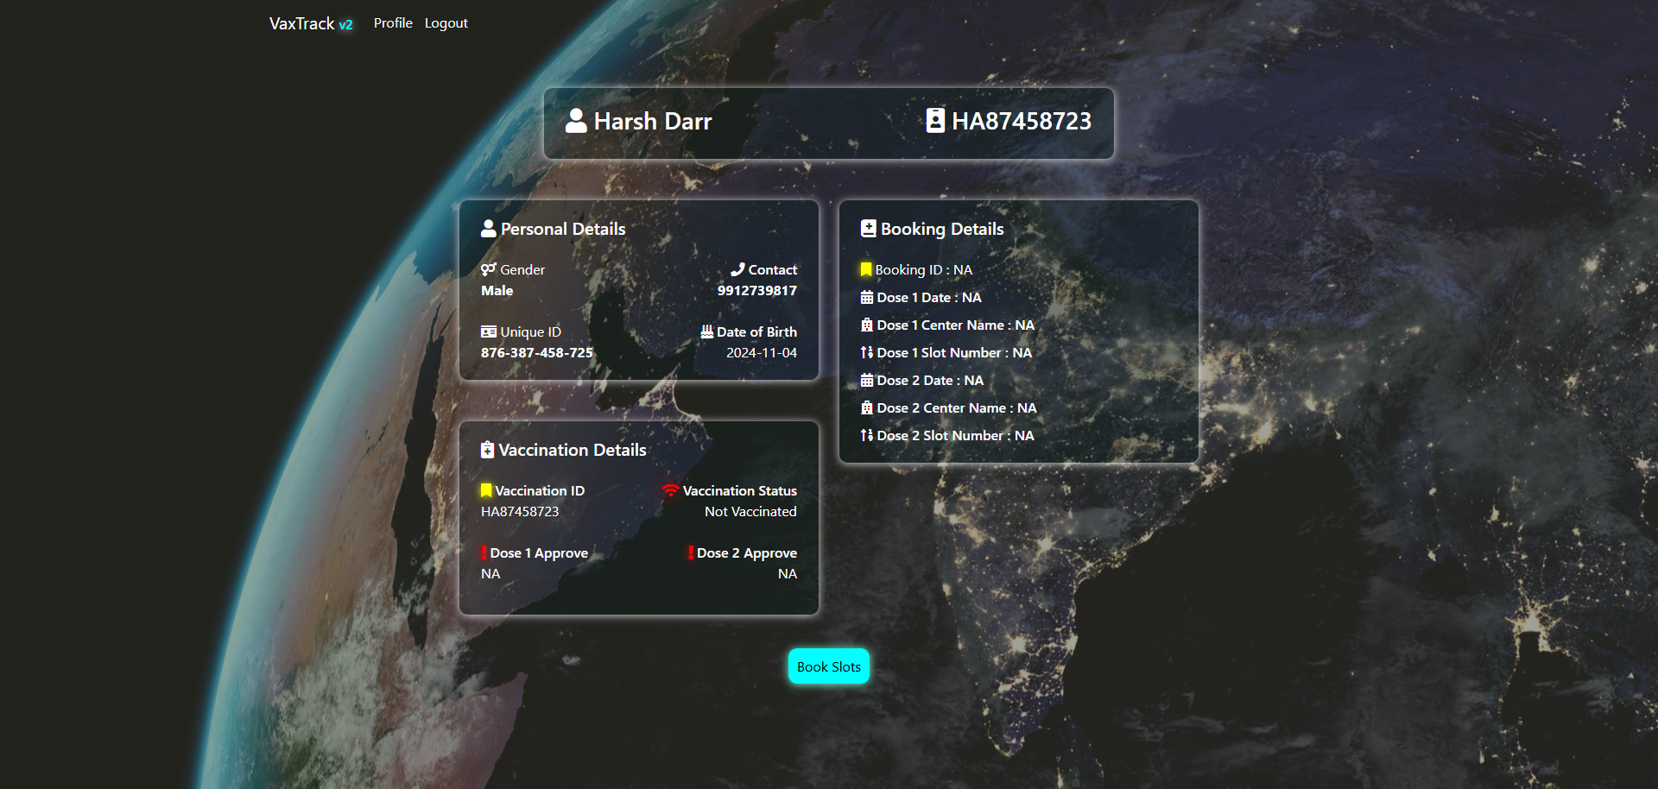
USER PROFILE PAGE – W/O BOOKED SLOT

Slide 14
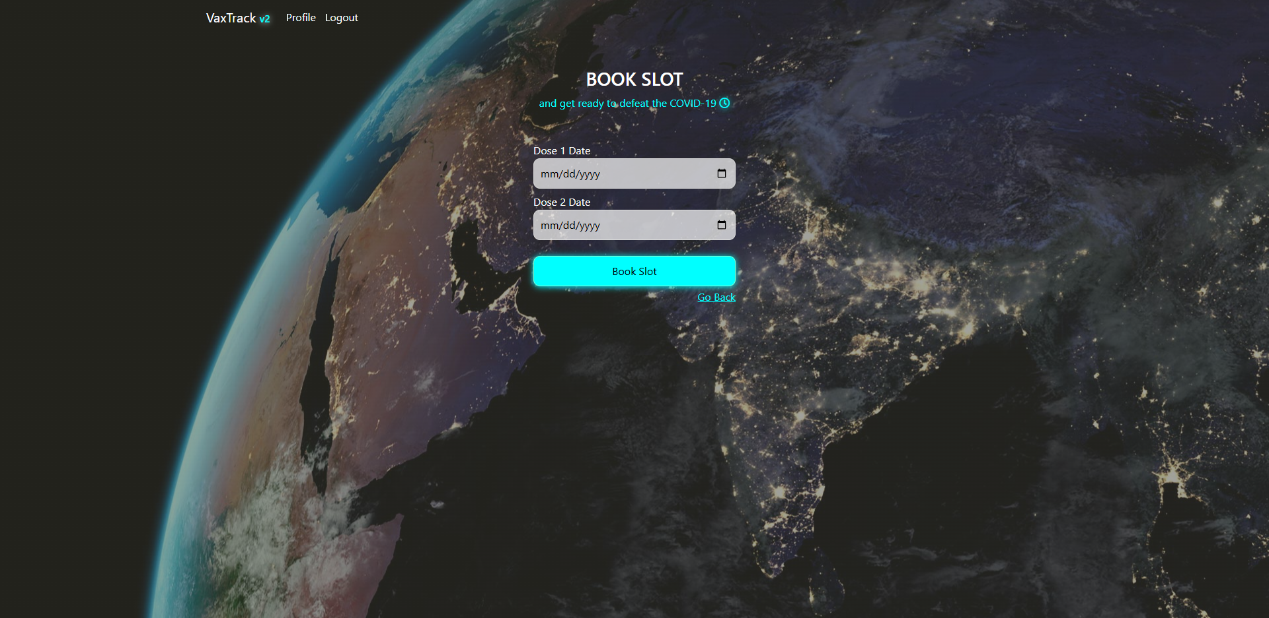
SLOT BOOKING PAGE

Slide 15
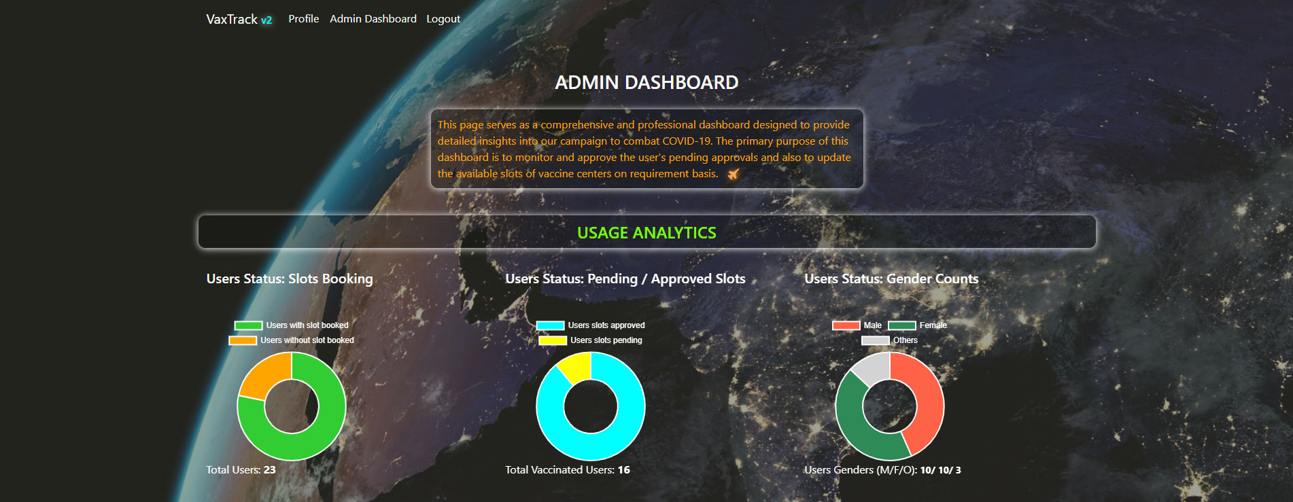
ADMIN DASHBOARD – USAGE ANALYTICS

Slide 16
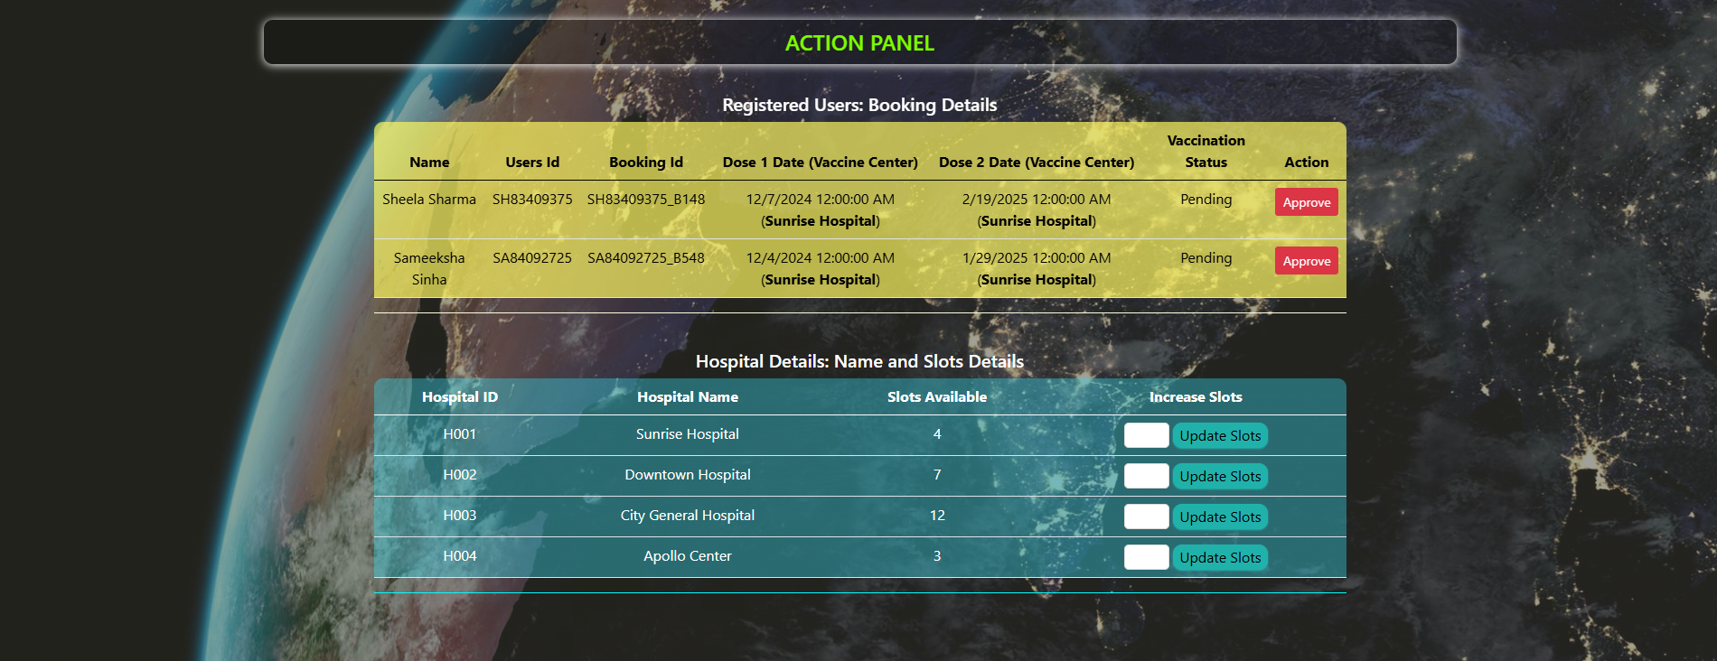
ADMIN PAGE – ACTION PANEL

Slide 17
ARCHITECTURE & DATABASE DESIGNS

Slide 18
ARCHITECTURAL DESIGN
Login & Registration Page
Admin Dashboard Page
Presentation Layer
Home Page
User Profile Page
Booking Page
Home Controller
Account Controller
User Profile Controller
Booking Controller
Admin Controller
Account Service
User Profile Service
Booking Service
Admin Service
Business Logic Layer
Auth Service
User Vaccine Details Service
Hospital Service
Data Access Layer
User Details DTO
Booking DTO
Admin DTO
User Vaccine Details DTO
Hospital DTO
Database Layer
User Details Model
User Vaccine Details Model
Booking Details Model
Hospital Model

Slide 19
DATABASE DESIGN
Booking Details Model
User Details Model
bookigId*
dose1Date
dose2Date
d1HospitalName
d2HospitalName
d1SlotNumber
d2SlotNumber
userId
userVaccinationId
userId*
userName
userBirthDate
userGender
userUid
userPhone
userRole
User Vaccine Details Model
Hospital Details Model
1 : 1
userVaccinationId*
userVccinationStatus
userId
1 : Many
1 : 1
hospitalId*
hospitalName
hospitalAvailableSlots

Slide 20
WORKFLOW DIAGRAMS

Slide 21
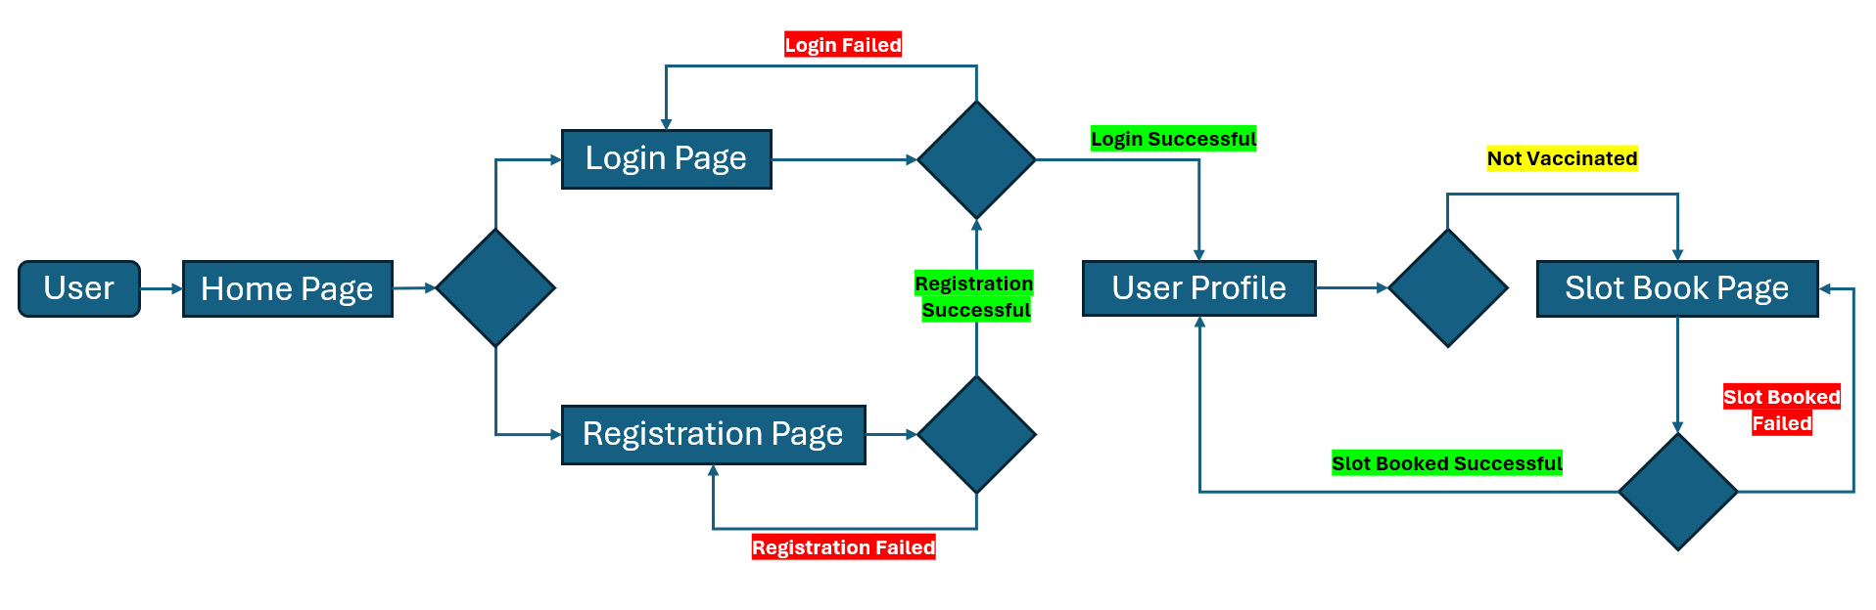
USER WORKFLOW

Slide 22
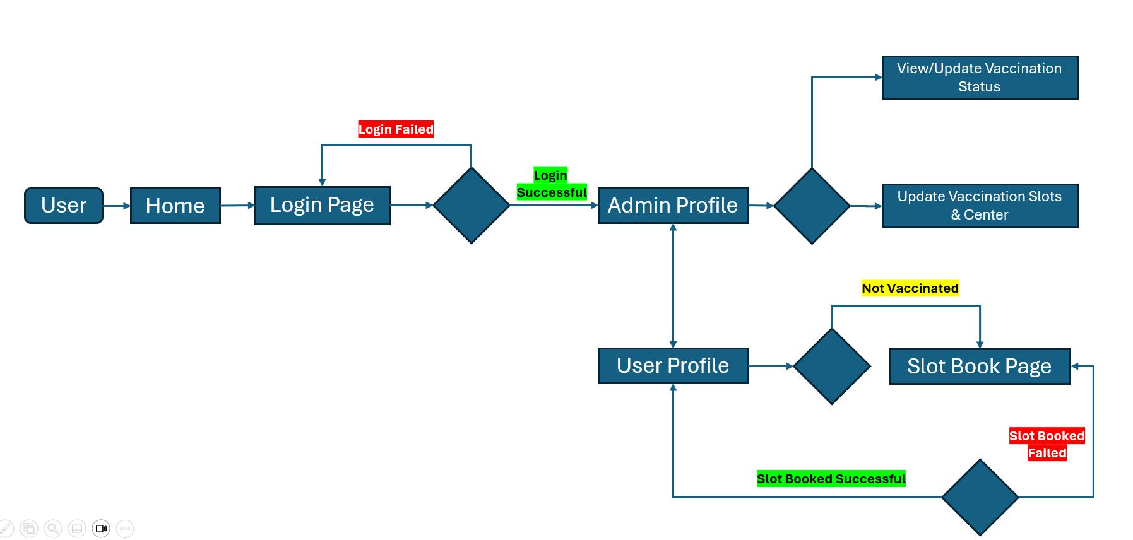
ADMIN WORKFLOW

Slide 23
CHALLENGES & SOLUTIONS
User Authentication and Authorization:
Challenge: Implementing a secure authentication and authorization system to protect user data and restrict access to certain parts of the application.
Solution: Integrated ASP.NET Identity for managing user authentication and roles, ensuring secure access control and data protection.
Responsive Design Implementation:
Challenge: Creating a responsive and user-friendly interface using HTML, CSS, and Bootstrap that works across various devices and screen sizes.
Solution: Leveraged Bootstrap’s grid system and responsive utilities to ensure the application adapts well to different screen sizes, enhancing the user experience on both mobile and desktop devices.
Database Integration with SQLite:
Challenge: Ensuring seamless integration of SQLite with ASP.NET MVC, particularly handling database migrations and schema updates.
Solution: Utilized Entity Framework Core for SQLite, which simplified database operations and provided robust migration tools to manage schema changes efficiently.
Password Strength Label with jQuery:
Challenge: Implementing dynamic labels to indicate password strength (e.g., weak, moderate, strong, highly strong) based on user input during registration.
Solution: Utilized code from GitHub to comprehend and integrate the password strength feature into the existing registration form, ensuring a seamless user experience.

Slide 24
FUTURE ENHANCEMENTS
Admin Dashboard Page:
Enhance the dashboard by incorporating additional charts (e.g., column, bar graphs) to provide detailed insights into registered users and their booking details.
User Profile Page:
Update the user details model to include an additional string field for profile pictures, allowing users to upload their profile images.
Slot Booking Page:
Introduce a partial vaccination feature, enabling users to book a single slot initially and select the second dose slot at a later time.
Feedback & Support:
Introduce a feedback form to collect user’s concern to enhance the portal features and deliverables.

Slide 25
FIXES & MODIFICATIONS
Restructured the application architecture.
Added a DTO layer (missing in previous version)
Normalized and restructured the model relationships (normalization was missing in previous version)
Redefined service methods based on the new model structure.
Redesigned and enhanced the admin page with additional charts for better insights.
Updated the all-over application UI.

Slide 26
CONCLUSIONS
To wrap up, our Vax Track vaccination portal, built with the ASP.NET MVC framework, simplifies the vaccination process for users and administrators alike. It offers easy registration, slot booking, and robust admin tools for managing approvals and slot availability. This project not only meets current needs but also sets the stage for future improvements in public health management. Thank you for your time.
Thank You
Vivek Kumar | Associate Consultant | Infosys

